Slide 1
Azure Solution Alignment Workshop
Module 3 – Azure Storage

Slide 2
High-level agenda
Azure Storage overview
Storage offerings
Storage availability and redundancy
Storage performance
Storage management
Storage deployment models

Slide 3
Discovery and Discussion
Standards or Compliance requirements?
High Performance Requirements?
Cloud Storage in use today?
CIFS, SMB, NFS?
Anticipated storage intensive workloads?
Tiered storage in use or planned?
Notes:
Use this slide to start an open conversation. This takes a more advanced consultative skillset to drive. If you do not feel comfortable in delivering this slide, it should be done by an Architect or Senior Consultant who has delivered many HCFs and perhaps is acting as the lead on the engagement. If those options are not possible, then you can uhide this slide and use the slides at the end to drive the questions.
The goal is to find out what they have. What they don’t have. Who owns, maintains and manages storage? Is it a team? Is there existing knowledge about the differences in storage in the cloud versus on-premises. Is the customer a blend of Windows and Linux? If Linux, are they big on NFS? CONFIDENTIAL: this is not a great story in Azure at the current time and into CY2018. If this is a need for the customer with NFS shares, you need to find out what their needs are and research the DLs for the current state of NFS in Azure.

Slide 4
Storage overview

Slide 5






Storage foundations
75 trillion
Available
Durable
Cost-effective
objects
11 million
Scalable
Secure
User friendly
Transactions/sec

Slide 6
Azure Storage Services
IaaS
PaaS
Virtual machines
Existing frameworks
Web and mobile
Microservices
Serverless Compute
Storage
Networking
Disks
Persistent disks for Azure IaaS VMs
Premium Storage Disks option: SSD based, high IOPS, low latency
Files
Fully Managed File Shares in the Cloud
SMB and REST access
“Lift and shift” legacy apps
Objects
Highly scalable, REST based cloud object store
Block Blobs: Sequential file I/O
Cool Tier Available
Page Blobs: Random-write pattern data
Append Blobs
Tables
Massive auto-scaling NoSQL store
Dynamic scaling based on load
Scale to PBs of table data
Fast key/value lookups
Queues
Reliable queues at scale for cloud services
Decouple and scale components
Message visibility timeout and update message to protect against unreliable dequeuers
Built on a unified Distributed Storage System
Durability, Encryption at Rest, Strongly Consistent Replication, Fault Tolerance, Auto Load-Balancing

Slide 7



Standard storage offerings
Blobs
Files
Queues
Tables
Disks
Object storage
access via REST
File storage
access via SMB, REST
Reliable messaging
access via REST
NOSQL storage
access via REST
IaaS VM VHD/ disks
access via REST
Streaming & random object access scenarios
Lift n shift scenarios
Scheduling async tasks
KeyValue Store
Persistent disks for VMs
Premium option

Slide 8
Azure Blob storage overview
Blobs
“Highly scalable, REST based cloud object store”
Blobs
Data sharing, Big Data, backups
Block Blobs: Read and write data in blocks. Optimized for sequential IO. Most cost-effective storage
Page Blobs: Sparse files, read/write in 512 byte pages. Optimized for random access
Blobs
Object storage
access via REST
Streaming & random object access scenarios

Slide 9
Azure Files overview
Blobs
“Highly scalable, REST based cloud object store”
Tables
“Massive auto-scaling NoSQL store”
Queues
“Reliable messaging at scale for cloud services”
Disks
“Persistent disks for Azure IaaS VMs”
Files
“SMB access to Azure Storage”
Files
Lift-and-shift on-premises applications
Natively supported by OS APIs, libraries, and tools
Built on SMB2.1, works with Windows and Linux
No limits on number of shares; 5TB and 1000 IOPS per share
Files
File storage
access via SMB, REST
Lift-n-shift scenarios

Slide 10
Azure Queues overview
Blobs
“Highly scalable, REST based cloud object store”
Tables
“Massive auto-scaling NoSQL store”
Queues
“Reliable messaging at scale for cloud services”
Disks
“Persistent disks for Azure IaaS VMs”
Files
“SMB access to Azure Storage”
Queues
Decouple components and scale them independently
Scheduling of asynchronous tasks
Building processes/work flows
No limits on number of queues or messages
Message visibility timeout to protect from component issues
UpdateMessage to checkpoint progress part way through
Queues
Reliable messaging
access via REST
Scheduling async tasks

Slide 11
Azure Table Storage overview
Blobs
“Highly scalable, REST based cloud object store”
Tables
“Massive auto-scaling NoSQL store”
Queues
“Reliable messaging at scale for cloud services”
Disks
“Persistent disks for Azure IaaS VMs”
Files
“SMB access to Azure Storage”
Tables
User, device and service metadata, structured data
Schema-less entities with strong consistency
No limits on number of table rows or table size
Dynamic load balancing of table regions
Best for key/value lookups on partition key and row key
Entity group transactions for atomic batching
Tables
NOSQL storage
access via REST
KeyValue Store

Slide 12
Azure Disks overview
Blobs
“Highly scalable, REST based cloud object store”
Tables
“Massive auto-scaling NoSQL store”
Queues
“Reliable messaging at scale for cloud services”
Disks
“Persistent disks for Azure IaaS VMs”
Files
“SMB access to Azure Storage”
Disks
All Azure IaaS VMs – Both OS and data disks
VHDs are backed to Page Blobs
3 synchronous, strongly consistent copies
Can stripe disks for more capacity/throughput
Premium Storage disks allow for scale up workloads
Disks
IaaS VM VHD/ disks
access via REST
Persistent disks for VMs
Premium option

Slide 13
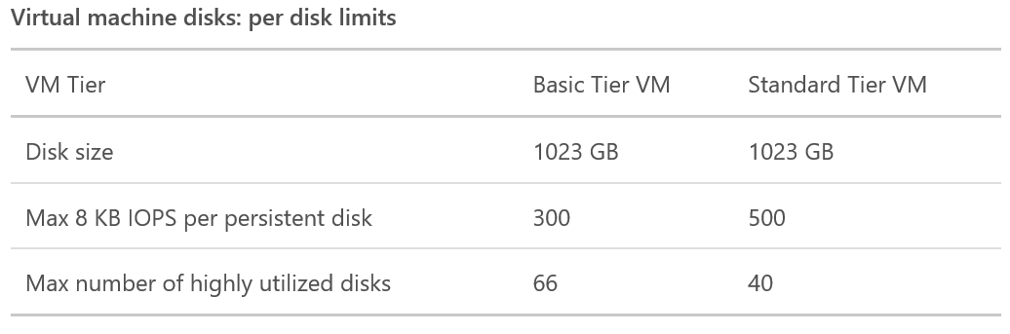
Standard vs. Premium Storage accounts
Standard
Includes Blob, Table, Queue, and File storage
VM disks store data on hard disk drives (HDDs)
Maximum total request rate of 20,000 IOPS
The total IOPS across all of your virtual machine disks in a standard storage account should not exceed this limit
If your VM disks do not require high IOPS, you can limit costs by maintaining them in Standard Storage
Can configure a custom domain name to use with your storage account

Slide 14
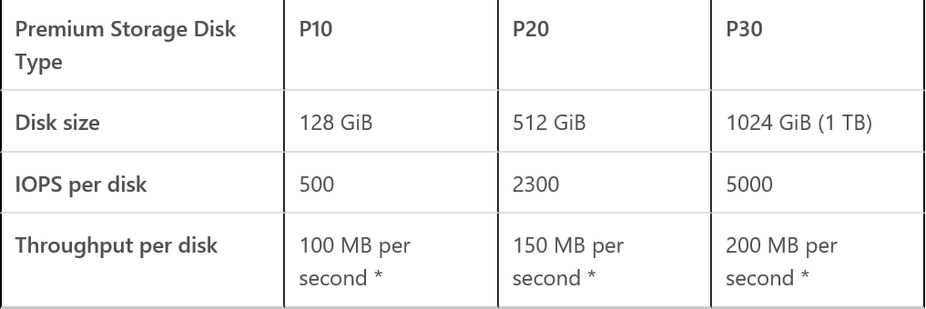
Standard vs. Premium Storage accounts
Premium
Recommended for virtual machine disks requiring high IOPS for the best application performance
VM disks store data on solid state drives (SSDs)
For your VM disks, you need to use the DS-series, FS-series, or GS-series of VMs
A premium storage account currently supports Azure Virtual Machine disks only

Slide 15
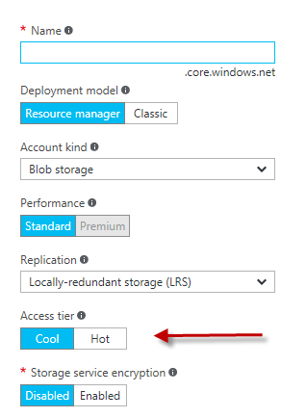
Hot versus cool storage
Azure hot storage tier is optimized for storing data that is accessed frequently
Azure cool storage tier is optimized for storing data that is infrequently accessed and long-lived
Backups, media content, scientific data, compliance, and archival data
In general, any data that is seldom accessed is a perfect candidate for cool storage

Slide 16
Cool Storage
Blob Tiers
Hot – for commonly used data
Cool – for rarely used data (GA: 4/16)
API is 100% identical; similar throughput and latency
Same durability options: LRS, GRS, RA-GRS
Pricing to match your workload
Hot: Lower access prices for frequent use
Cool: Lower storage prices for high volume
Switch account tiers as needed
Blob REST API
Blob Storage Account
Hot Tier
Lower Transaction cost
Blob Storage Account
Cool Tier
Lower Capacity cost
Account level conversion

Slide 17
Cool storage
Cost-effective: Storage cost as low as $0.01 per GB in some regions
Compatibility: 100% API compatible with our existing Blob storage offering
Performance: Similar performance profile for latency and throughput
Availability:
Hot access tier: Availability of 99.9%
Cool access tier: Availability of 99%
Durability: Same high durability; same data replication options
Scalability and security: Same scalability and security features

Slide 18
Azure Blobs

Slide 19
What is the Blob Storage Service?
Azure’s Object Storage platform
Store and serve unstructured data
App and Web scale data
Backups and Archive
Big Data from IoT, Genomics, etc.
Types of Blobs
Block Blobs - Most object storage scenarios
Append Blobs - Multi-writer append only scenarios
Page Blobs - Page aligned random reads and writes
Image.jpg
Block 1
Block 2
Block 3
Block 4
512
1024
1536
2048
Sparse File
512 byte aligned
2560

Slide 20
Blob Storage – Key Capabilities
Strong consistency
Multiple Redundancy types – LRS, GRS, RA-GRS
Tiered Storage – Hot & Cool tiers
Broad platform and language support
Supports top level directory/isolation structure – “containers”

Slide 21
Azure Disks

Slide 22
Azure Disks: Overview
What are Azure Disks?
Persistent data disks for Azure IaaS VMs
Two types of durable storage: Premium Disks (SSD) & Standard Disks (HDD)
Backed by Page Blobs in Azure Storage
Capabilities
Available in all Azure Regions (Premium Disks as well*)
Server Side Encryption at Rest, Azure Disk Encryption (BitLocker/DMCrypt)
Managed Disks for many benefits
Differentiators
Enterprise grade durability with three replicas
High I/O performance and low latency (>80,000 IOPS and >2,000 MB/sec disk throughput per VM)
Specialized VMs with Blob Cache technology
REST Interface for developers

Slide 23
Azure Disks: Premium vs. Standard Storage Disks
 | Premium Storage Disks | Standard Storage Disks
Disks Types | SSD | HDD
Recommended Workloads | Mission critical applications which require high-performance, high-availability, and low latency for IO-intensive Enterprise workloads | Infrequently accessed data and Dev/Test workloads
Performance Expectations | 5,000 Provisioned IOPS and 200 MB/sec throughput for 1 TB disk 80,000 Provisioned IOPS and 2,000 MB/sec throughout with GS5 (largest VM) Single digit millisecond latency Consistency of provisioned performance | Up to 500 IOPS and 60 MB/sec for 1 TB disk 32,000 IOPS with G5 (largest VM) Performance is not provisioned

Slide 24
Premium Storage Performance
IOPS and Throughput
Are separate limits, enforced independently
Throttling kicks in when either of the limits are reached
VM Size and Disk Size
Enforce independent limits on VM and Disk
Chose the right configuration based on workload needs
Optimal Traffic Patterns
Larger IO sizes for higher Throughput. Smaller IO sizes for higher IOPS.
Use multiple parallel operations / threads to push more traffic
Avoid heavy bursts by reducing the IO buffer to <5% of the IO limits
Limits | IOPS | Throughput
P30 (1 TB) Disk | 5,000 | 200 MB/sec
DS3 VM | 12,800 | 128 MB/sec
Notes:
Explain what is IOs (when explaining about IO and throughput)

Slide 25
Azure Files

Slide 26
Azure Files: Overview
Fully Managed Cloud File Storage
Scenarios
Lift and Shift (E.g. DFSN, FTP Server migration)
Host high availability workload data (E.g. IBM MQ)
Enable backup and disaster recovery (E.g. SQL backups)
Capabilities
Protocols: SMB 2.1, 3.0, and REST
Multi-OS support: Mount from both Windows & Linux
Accessible from both On Premise and IaaS instances
Three strongly consistent copies for durability
99.9% availability SLA

Slide 27
Azure Files vs. Disks
 | Azure Files | Azure Disks
Scenario | Life & Shift applications which leverage native file system | Persistent disks to Azure Virtual Machines
Protocol | SMB 2.1/3.0, REST | VHD, REST
Accessibility | SMB – Worldwide (requires Port 445) REST – Worldwide | VHD – Azure Data Center REST (Page Blob) – Worldwide
Durability | LRS, GRS | LRS, GRS, RA-GRS (for Page Blob)
Object Size | Up to 1 TB file | Up to 1 TB Disks (Can stripe up to 64 disks on G VM)
Max IOPS (8K) | 1000 | 5000 (Premium) 500 (Standard)
Throughput | Up to 60 MB/s per share | Up to 200 MB/s per disks (Premium) Up to 60 MB/s per disk (Standard)
 | Azure Files | Azure Disks
Scenario | Life & Shift applications which leverage native file system | Persistent disks for Azure Virtual Machines
Protocol | SMB 2.1/3.0, REST | VHD, REST
Accessibility | SMB – Worldwide (requires Port 445) REST – Worldwide | VHD – Azure Data Center REST (Page Blob) – Worldwide

Slide 28
Highly available & redundant

Slide 29
Location, durability, and redundancy models
Locally Redundant Storage (LRS)
Provides economical local storage or data governance compliance. Higher throughput than GRS
Zone Redundant Storage (ZRS)
Provides economical, yet higher durability option for Block Blob storage. Replicated within and across regions
Geographically Redundant Storage (GRS)
Provides protection against a major datacenter outage or disaster
Read-Access Geographically Redundant Storage (RA-GRS)
Provides read access to data during outages. Plan to design GRS, in general. That is, unless the workload already accounts for it

Slide 30
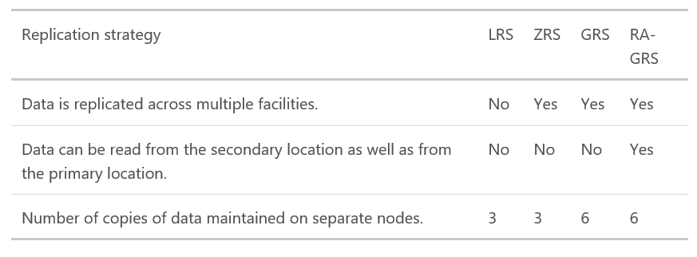
Replication strategy details
Replicas reside in separate fault domains and upgrade domains
Fault Domain = Group of nodes that represent a physical unit of failure (rack)
Upgrade Domain = Group of nodes that are upgraded together during a service rollout

Slide 31
Primary and secondary replication regions
Primary | Secondary
North Central US | South Central US
South Central US | North Central US
East US | West US
West US | East US
US East 2 | Central US
Central US | US East 2
North Europe | West Europe
West Europe | North Europe
South East Asia | East Asia
East Asia | South East Asia
East China | North China
North China | East China
Japan East | Japan West
Japan West | Japan East
Brazil South | South Central US
Australia East | Australia Southeast
Australia Southeast | Australia East
India South | India Central
India Central | India South

Slide 32
Managed Disks

Slide 33
Managed Disks Overview
Hides complexity of storage accounts and scale limits
Simpler management for customers
Better performance
Storage account limits do not apply
Granular access control
Top level ARM resource, apply Azure RBAC
Smarter about Availability sets
Different fault domains – Disks in different Storage clusters
Easy migration from Standard to Premium
Minimal downtime with background migrations
Availability Set
Fault Domains: 3
42
500
41
20K IOPs
SQL1
FD:1
SQL2
FD:2
500
SQL3
FD:3
40
…
…
Disk Service
Blob1
Blob2
500
Blob3
2
…
20K IOPs
1
Storage Cluster FD1
Storage Cluster FD2
500
Storage Cluster FD3
VMs
500
Disk Resource
Provider
Disk Resource
Provider Storage Accounts

Slide 34



Enhanced Availability - Availability set isolation
Unmanaged
VS
Managed
Unmanaged ARM availability set
Managed ARM availability set
VMs susceptible to storage single point of failure
Separated storage units align to fault domains
FD0
FD1
FD3
FD0
FD1
FD3
Storage account 1
Storage account 2
Storage account 3
Storage unit 1
Storage unit 1
Storage unit 2
Storage unit 3
Isolated managed disks
Notes:
Availability Set Isolation
Disks for different VMs in the Availability Set are placed in different fault domains for isolation of failure points
Provides better reliability for Availability Sets

Slide 35
Feature highlights – Service management
Simplified service management experience
Just create the VMs/disks and manage them – No need to manage the storage account/Blobs
Eliminates the need to upload Custom Images to every storage account
Managed Disk will support typical disk operations like copying, snapshots, etc. at disk level
No dependency on Storage Account limits
VM/Disks creations are not constrained by storage account IOPS limits
VM deployments are not constrained by limited number of storage accounts allowed per subscription
There will be separate subscription quotas for Managed Disks

Slide 36
Performance and reliability
VM/Disk performance and scalability
Disk performance is not impacted by storage account IOPS limits
Avoids VM crashes caused by storage account IOPS limits
Optimized network connectivity for Premium Storage disks and VMs for better performance
Overall improvements to VM/disk deployments and scalability
Availability set isolation
Disks for different VMs in the availability set are placed in different fault domains for isolation of failure points
Provides better reliability for availability sets

Slide 37
Competitive Value
Overall Simplicity
Competitive Parity with Azure Web Service (AWS) Elastic Block Store (EBS)
Do not need to understand storage accounts to use Azure Virtual Machine (VM)
Do not need to understand fault domains to benefit from aligning VM and storage fault domains
Notes:
The main benefit to customers is a simpler way to work with disks.
This makes disk storage in Azure more comparable with Azure Web Service (AWS) and which doesn’t burden the customer with concepts like storage accounts and fault domains

Slide 38
Managed Disks Sizes
Premium Managed Disk Type | P4 | P6 | P10 | P20 | P30 | P40 | P50
Disk Size | 32 GB | 64 GB | 128 GB | 512 GB | 1024 GB (1 TB) | 2048 GB (2 TB) | 4095 GB (4 TB)
Standard Managed Disk Type | S4 | S6 | S10 | S20 | S30 | S40 | S50
Disk Size | 32 GB | 64 GB | 128 GB | 512 GB | 1024 GB (1 TB) | 2048 GB (2 TB) | 4095 GB (4 TB)

Slide 39
Managed Disks and Encryption
Storage Service Encryption (SSE)
Provides encryption-at-rest and safeguard your data to meet your organizational security and compliance commitments.
Enabled by default for all Managed Disks, Snapshots and Images
Azure Disk Encryption (ADE)
Allows you to encrypt the OS and Data disks used by an IaaS Virtual Machine, including managed disks.
For Windows, the drives are encrypted using BitLocker encryption technology.
For Linux, the disks are encrypted using the DM-Crypt technology.
Integrated with Azure Key Vault to allow you to control and manage the disk encryption keys.

Slide 40







Easy upgrade from Standard to Premium
Update to Premium capable VM size
Update storage type to Premium
Reboot
Stop the VM
3-5 minutes of downtime

Slide 41
Performance considerations

Slide 42
Storage account structure and targets
Storage account
Capacity: 500 TB
IOPS: 20000
Bandwidth: Up to 30 Gbps
Container
Container
File share
Queue
Table
Block Blob/ Append Blob
Disk / Page Blob
File
Message
Entity
Throughput: 60MB/s or 500 request/s
Max size: 200 GB
Throughput: 500 8K IOPS
Max size: 1 TB
Throughput: 60MB/s
Max file size: 1TB
Max file share size: 5TB
Throughput: 2000 1KB messages/s
Max message size: 64KB
Throughput for single partition : 2000 1KB Entities/s
Max entity size: 1 MB
Premium
Bandwidth: up to 50 Gbps
Total disk capacity: 35 TB
Max IOPS/ per VHD: 5000

Slide 43
Perf and scale considerations – Storage account
Shared across multiple accounts for large capacity, IOPS
Leverage partitioning effectively to manage read/write
Use CreateIfNotExists judiciously
Leverage exponential backoff
Storage account IOPS will dictate number of disks
20,000 IOPs/500 IOPs per disk = ~40 VHDs per storage account
https://docs.microsoft.com/en-us/azure/storage/storage-performance-checklist

Slide 44
Perf and scale considerations – Blobs
Small Blobs
Disable Nagle algorithm
Turn off Proxy Auto Detection
Treat parallelization with caution
Complete upload/download in single call
Large Blobs
Split one Blob into many to get more IOPS
Chunk prior to download and parallelize
Leverage range downloads as appropriate
Turn off proxy auto detection
Disable Expect100Continue
Increase DefaultConnectionLimit property
Create replica of your Blobs for many (>25) readers
https://docs.microsoft.com/en-us/azure/storage/storage-performance-checklist#blobs

Slide 45
Perf and scale considerations – Tables
Plan your partition keys and row keys
Specify both partition keys and row keys to avoid scans
Use compound key values
Use query projection
Avoid spiky traffic if possible
https://docs.microsoft.com/en-us/azure/storage/storage-table-design-guide https://docs.microsoft.com/en-us/azure/storage/storage-performance-checklist#tables

Slide 46
Perf and scale considerations – Other services
Queues:
PeekMessage over GetMessage
Create multiple queues and round robin to get greater IOPS
Disks/Page Blobs:
Download a snapshot instead of downloading disk
Split into multiple disks to get more IOPS
Use GetPageRanges to download only what you need
Files:
Use SMB V REST appropriately
Leverage many shares for greater throughput
Use CORS for direct access from browsers
https://docs.microsoft.com/en-us/azure/storage/storage-performance-checklist

Slide 47
Recommendations
Review the Storage Performance and Scalability checklist
Enable analytics metrics and logs during testing and in production – duration aligns with your bug resolution window
Establish baselines during testing measure against those as you launch
Introduce errors during testing, fail gracefully
Select the right resource for right problem – Tables vs. Blobs
Consider scalability targets while designing your application
Use RA-GRS to provide 99.99% read availability
Review storage guidance for patterns from our largest customers

Slide 48
Storage management

Slide 49
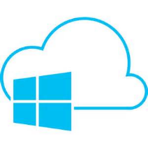

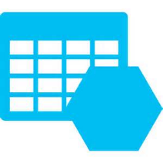
Storage management
Data in Azure Storage can be accessed and managed in a variety of ways, through numerous tools and processes.
Graphical user interface
Command-line interface
REST interface
Client libraries
Cross-platform
Vendor solutions

Slide 50
Azure Storage monitoring and diagnostics
Metrics
"Service health statistics"
Analytics Metrics
PerfMon for Storage
>40 metric types for Blobs, Tables, and Queues
Summarized by hour and minute (w/ < 5 min delay)
Granularity and retention policies
Stored in tables – e.g. $MetricsMinuteTransactionsBlob

Slide 51
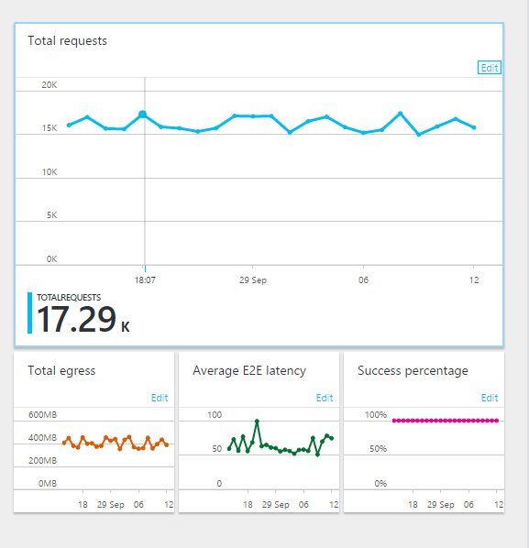
Storage metrics
The storage metrics feature is available in the Azure portal to help you monitor your storage performance. Storage metrics can be thought of as an equivalent to the “Windows Performance Monitor” counters in the Microsoft Azure service.

Slide 52
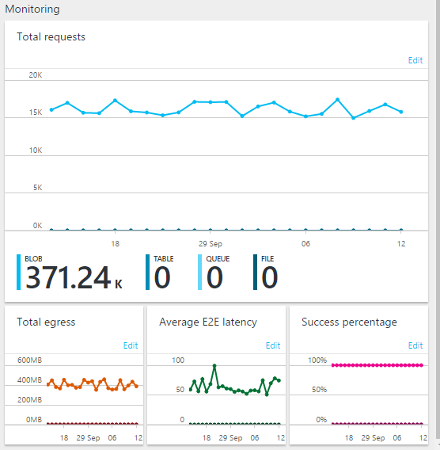
Monitoring availability
Monitor the availability of the storage services in your storage account by monitoring the value in the “Availability” column in the hourly or minute metrics tables.
Notes:
The availability of your storage should be at 100%. If not you will need to identify what is causing a degradation of your storage.

Slide 53
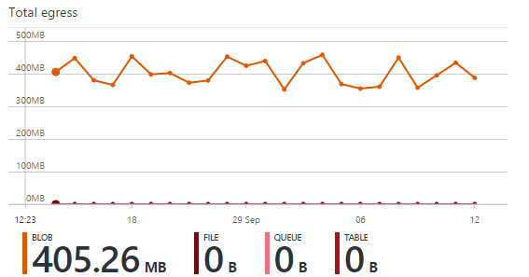
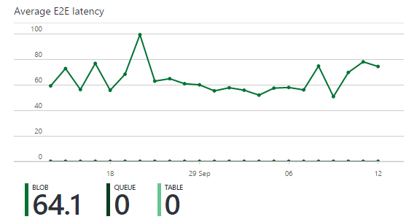
Monitoring performance
There are multiple areas in your storage services that you should monitor for performance trends.
Some of key areas to monitor include:
AverageE2ELatency
Total Ingress
Total Egress

Slide 54
Azure Storage monitoring and diagnostics
Metrics
"Service health statistics"
Logs
"Service trace logs"
Analytics logs
Storage equiv. of IIS logs
All REST operations are logged
Includes most request characteristics
Timestamp, Status Code, Operation, E2ELatency, etc.
Granularity and retention policies
Use this for diagnosis and troubleshooting
Stored in Blobs in a container called $logs

Slide 55
Azure Storage monitoring and diagnostics
Metrics
"Service health statistics"
Logs
"Service trace logs"
Client logs
"Client trace logs"
Client Logs
Detailed tracing for client operations
All libraries include logging
Use platform appropriate logging conventions
Useful for investigating client, network, SAS errors

Slide 56
Azure Storage monitoring and diagnostics
Metrics
"Service health statistics"
Logs
"Service trace logs"
Client logs
"Client trace logs"
Network
"Network trace logs"
Network logs
Familiarity with network logging tools useful – especially for client performance issues
Fiddler – useful for simple HTTP / HTTPS
Wireshark / Message Analyzer – useful for lower level network issues

Slide 57
Azure Storage monitoring and diagnostics
Metrics
"Service health statistics"
Logs
"Service trace logs"
Client logs
"Client trace logs"
Network
"Network trace logs“
Correlation
"End-to-end tracing"
Correlation
Often need to analyze storage, client, and network logs together
ClientRequestId – Unique Id per logical operation – batch and retries use same ClientRequestId
Client - Appears in OperationText field
Network – x-ms-client-request-id
Storage – Client-Request-Id
ServerRequestId – Unique Id per operation
Client – Appears in OperationText field
Network – x-ms-request-id
Storage – request-id-header

Slide 58
Azure Storage Explorer
https://azure.microsoft.com/en-us/blog/microsoft-azure-storage-explorer-preview-january-update-and-roadmap/

Slide 59
Data protection

Slide 60
Storage protection
At-rest
In-transit
Access
Subscription
Storage Service Encryption can be enabled at a storage account level:
Block Blobs, Append Blobs, and Page Blobs
Archived VHDs and templates brought to Azure from on-premises
Underlying OS and data disks for IaaS VMs created using your VHDs
Transport encryption of traffic traversing exposed virtual machine network endpoints using first-party and third-party mechanisms. Technologies:
HTTPS/REST API
Azure endpoints
Azure Import/Export Service
Shared access keys (SAK) and signatures (SAS) to provide access to data stored in Queue, Table, and Blob storage. Technologies:
Shared Access Signatures
Storage Account Access Keys
Storage Account endpoints
IaaS
Exposed in one or more Storage Accounts within each Azure subscription
Data residing within Storage Accounts does not reside on a single disk
Microsoft protects the data stored within each datacenter with a comprehensive set of controls in alignment with the security certifications outlined at the Azure Trust Center
Service

Slide 61
Storage protection
At-rest
In-transit
Access
Subscription
Encryption of data located in Queue, Table, and Blob storage using first-party encryption mechanisms. Technologies:
Key Vault
Client-side encryption
Azure SQL Database
TDE
Azure Storage service encryption
Transport encryption of traffic traversing storage account network endpoints using first-party and third-party mechanisms. Technologies:
HTTPS/REST API
Storage Account endpoints
Shared access keys (SAK) and signatures (SAS) to provide access to data stored in Queue, Table, and Blob storage. Technologies:
Shared Access Signatures
Storage Account Access Keys
Storage Account endpoints
Exposed in one or more Storage Accounts within each Azure subscription
Data residing within Storage Accounts does not reside on a single disk
Microsoft protects the data stored within each datacenter with a comprehensive set of controls in alignment with the security certifications outlined at the Azure Trust Center
Service

Slide 62
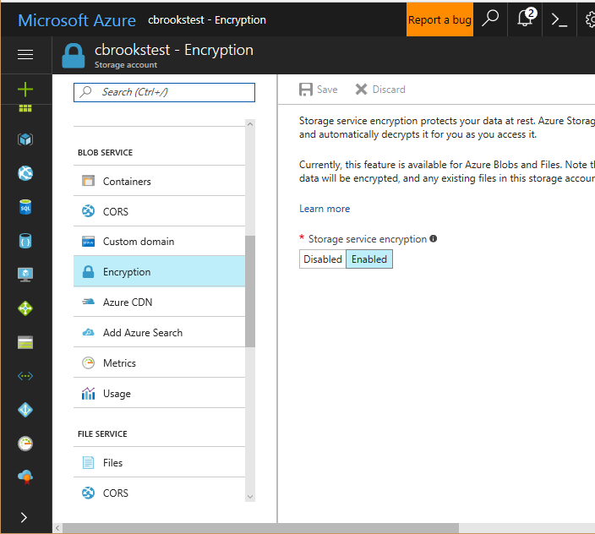
Encryption At Rest – Storage Service Encryption
Prevents data disclosure from physical disk compromise
Available now for Blobs with Microsoft managed keys
H2 2017 – Encryption enabled for all accounts
Customer managed encryption keys - Preview H2 2017

Slide 63
Encryption In Transit
Storage REST APIs support HTTPS
SAS Tokens can be restricted for HTTPS only
New - “Secure Transfer” option
Limit all access to HTTPS only
Enables control via ARM Policy and monitoring via Azure Security Center
Available in H2 of 2017

Slide 64
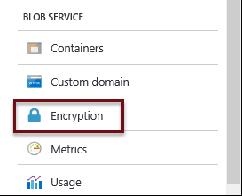
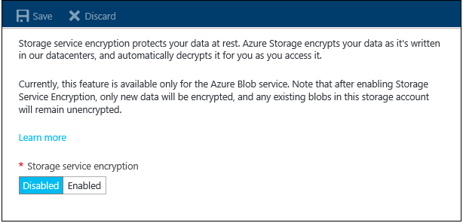
Azure Storage Service Encryption (SSE)
SSE encrypts data when it is written to Azure Storage in Block Blobs, Page Blobs, and Append Blobs. It works for the following:
General purpose storage accounts and Blob storage accounts
Both Standard and Premium storage
All redundancy levels (LRS, ZRS, GRS, RA-GRS)
Azure Resource Manager storage accounts
Note: Encryption of classic storage accounts and classic storage accounts migrated to Resource Manager storage accounts is not supported
Encryption of archived VHDs and templates brought to Azure from on-premises
Encryption of underlying OS and data disks for IaaS VMs created using your VHDs
All regions
Note: SSE only encrypts newly created or copied data after the encryption is enabled

Slide 65
Storage security models
Internal (Private) vs. External (Public) Access
Start with internal (private) access only, then find reasons (exceptions) why the data needs external (public) access
Most companies do not need external (public) access to their data
Storage Accounts and Storage Keys
Provide shared access signatures, without having to give out your access keys. SAS tokens, allow access to storage accounts for an interval period of time with the permissions you specify. Also allowing a more granular permissions to resources
Specify a container to be public to allow users anonymous access for read operations without having to provide credentials

Slide 66
Application-layer encryption
Encrypt storage data in your applications
Automatically encrypt prior to sending to storage
Automatically decrypt after receiving from storage
Seamless integration
Blobs – Full Blob upload; full or range download
Tables – Read/insert /replace of entities with configurable attributes; batch operations
Queues – Messages individually encrypted
Benefits
Storage service never sees your keys or unencrypted data
Proven security practices - Standard envelope encryption, key rotation, etc.
Self contained – Key meta-data stored with each object
Interoperable across storage client libraries
Source code available on GitHub

Slide 67
Key Vault integration
Microsoft cannot access your secrets
Manage, rotate, monitor master encryption keys and secrets
Contents are protected at rest with HSMs
Authentication via Azure Active Directory
Role separation between key owners and data manipulation
Storage Client Library enables optional Key Vault integration
Enables content encryption key to be wrapped/unwrapped
Enables multiple key sources to be aggregated
Enables caching of keys for high-scale, low-latency storage operations

Slide 68
Storage access control strategies
Multiple access control strategies
Storage account key – Full access
Shared access signature (SAS) – Token with configurable rights and time
Public – Blob storage only
Shared access signature
Resources – Account (coming soon), containers, Blobs, queues, tables, table ranges
Permissions – Read, write, delete, etc.
Time – Start time, end time
https://storageaccount.blob.core.windows.net/sascontainer?sv=2012-02-12&se=2013-04-13 T00%3A12%3A08Z& sr=c&sp=wl&
sig=t%2BbzU9%2B7ry4okULN9S0wst%2F8MCUhTjrHyV9rDNLSe8g%3Dsss

Slide 69
Key decisions
Notes:
If you did not gather enough requirements in the Discovery and Discussion slide a the beginning of the deck.

Slide 70
Storage account types and services decisions
Mandatory
Single storage account Limit: 500 TB. If exceeded, a new storage account must be created
Azure File Share Limit: 5TB. If exceeded, a new file share must be created
Recommended
Consider Premium Storage for higher level of disk performance for a given workload or application
Premium Storage accounts are required for single-instance VM SLAs

Slide 71
Storage account types and services decisions
Considerations | Decision points
Storage accounts for different purposes | Decide how to allocate storage accounts for a specific purpose within a project
Storage services for unique capabilities | Decide on the type of data and data flow that the storage account will serve to determine the storage service that the account will provide
Blob Storage: Block Blob vs. Page Blob | Decide the use of wither Block Blob or Page Blobs when creating Blob storage
Storage and Access for Random Access Data | Decide when to use Azure Blobs, Azure Files, or Azure Data Disks

Slide 72
Storage account types and services decisions
Considerations | Decision points
Storage costs | Consider costs involved when deciding how data is stored and accessed Total costs will depend on amount of data stored, volume of storage transactions, outbound data transfer, and which redundancy option chosen
Containers for organizing data | Decided how data will be organized in Azure Storage
Concurrency settings | Decide if whether your modern application will have multiple users viewing and updating simultaneously. Developers must take into consideration a predictable experience for users, where multiple users can update the same data Decided on Optimistic Concurrency, Pessimistic Concurrency, and Last writer wins
Storage account limits | Consider size and throughput limitations on each storage account Throughout limitation is likely hit before size limitation Consider the limit of storage accounts per subscription and decided how many storage accounts will be actually needed
Amount of storage accounts for use | Use multiple storage accounts for scaling. Decide on a design where IaaS and PaaS workloads add storage accounts dynamically

Slide 73
Naming convention decisions
Avoid Blob names that end with a dot (.), a forward slash (/), or sequence/combination of the two. Don’t use the (\) in a Blob name as it mail fail to hash properly
Storage accounts and container names are changed only by deleting and re-creation of a new one
Mandatory
Recommended
Establish a naming convention for all storage accounts and types before creating any

Slide 74
Storage naming conventions
The choice of a name for any asset in Microsoft Azure is an important choice because:
It is difficult (though not impossible) to change that name at a later time and there are certain constraints and requirements that must be met when choosing a name
This tables covers the naming requirements for each element of a storage account
Item | Length | Casing | Valid characters
Storage account | 3-24 | lowercase | alphanumeric
Blob name | 1-1024 | case-sensitive | any url char
Container name | 3-63 | lowercase | alphanumeric and dash
QueueName | 3-63 | lowercase | alphanumeric and dash
TableName | 3-63 | case-insensitive | alphanumeric

Slide 75
Location, durability, and redundancy decisions
Mandatory
ZRS is only available for Block Blobs. Decide on the storage type before selecting the redundancy type
GRS allows to select the primary region, however the secondary region cannot be changed
Recommended
Decide the regions to use for storage as not all storage services are available in all regions
Optional
Recommendation is GRS over ZRS or LRS for maximum durability, while noting price differences
It’s possible to change how your data is replicated, however consider the costs for data transfer from LRS to GRS or RA-GRS

Slide 76
Location, durability, and redundancy decisions
Considerations | Decision points
Levels of redundancy | Decide on the level of redundancy for your data. Not all data needs the same level of redundancy Decide on less expensive LRS over GRS, as LRS offers higher throughput. If data can be easily reconstructed, decide on LRS Decide on regions where data is allowed due to data governance or privacy requirements, and decide on redundancy option to choose For applications with their own replication strategy, e.g. SQL AlwaysOn and AD DS, GRS might not be needed ZRS is only available for Block Blobs. Decide on whether to make a storage account zone-redundant, as you cannot convert it into another type of replication and vice versa
Planning with failure in mind | Decide on redundancy options as needed, as failures are a reality. Hardware failures are part of running a hyper-scale datacenter

Slide 77
Storage security decisions
Decide on Azure storage access key management when accessing storage accounts through GUI tools, e.g. Azure Storage Explorer
Periodically change the primary and secondary access keys for the storage accounts to mitigate unauthorized access (every 60-120 days)
When changing the keys, ensure you specify the change in the application. Do not change both keys at the same time as this might result in loss of access by the applications
Mandatory

Slide 78
Storage security decisions
Only generate the storage account keys if necessary as various services and clients get affected by this change
Optionally, decide on using Shared Access Signature for storage account access to users
Enable SSE before copying data to it
Recommended
Decide on public access by setting container’s permissions for Blob. Or signed access via shared access signatures to containers, Blob, queues, or tables
Optional

Slide 79
Storage security decisions
Considerations | Decision points
Internal (private) vs. external (public) access | Decide on the type of access control for the storage account entirely depending on the type of data and how this data needs to be accessed and protected
Storage accounts and storage keys | Decide on limiting storage keys to a limited few, as these are highly privileged credentials (e.g. domain admin credentials)

Slide 80
Storage for IaaS decisions
Mandatory
Ensure all VMs or images planned for migration use the VHD format as Azure does not support VHDX
Dynamic VHD is converted to fixed VHD when uploaded to Azure
Do not Store data on the temp disk of a VM, as all data will be lost when a failure happens or de-provisioning of the VM. Decide to use temp storage for transient data such as page files or swap files
Decide on using a CDN for distributing Blob in the case you have multiple clients that need to read the same Blob, and you might exceed the limit of 60MB/second single Blob read or write. A single Blob supports up to 500 requests per second
Recommended
Optional
Decide on the appropriate size for the VM, based on the number of data disks that you anticipate needing. Different VMs sizes allow for different number of data disks to be attached

Slide 81
Storage for IaaS Decisions
Considerations | Decision Points
IaaS Design Storage Account Dependency | Understand the I/O (IOPS) and profile of workloads to determine the expectations put on storage accounts. Based on this, decide how VHDs should be stored in storage accounts and the available limitations.
VM Images and Storage Account Dependency | Decide on which storage account should be used for images versus live VMs when uploading and deploying images.
Multiple data disks in single volumes | If multiple data disks are needed to appear as a single volume within a VM. You are limited to use KKRS only and cannot use GRS for those VHDs
Disk Cache and VM Performance | Decide on whether to enable or disable the host caching setting for OS and data disks. These settings can also negatively affect performance in other circumstances depending on the application.

Slide 82
Storage Management Decisions
When importing the publish settings file, the information to access your azure subscription is located in your user directory. Take additional steps to encrypt your user directory to protect this info.
When using the Import/Export service, the data on the drive must be encrypted using BitLocker prior to creating the job. Additionally, a shipping tracking number must be provided.
Mandatory
Recommended
Azure storage supports both HTTP and HTTPS, however, HTTPS is recommended.
Optional
Shipment might cross international borders, verify with advisors that your media and data can legally be shipped to the destination datacenter.

Slide 83
Storage management decisions
Examine the suitability of placing data into Azure. Explore the three primary factors:
Considerations | Decision points
Access frequency | If data is accessed in a frequent or regular basis then it may not be a good candidate to store in the cloud Data access less frequently, such as archived data, is better suited for the cloud
Active data vs. passive data | Additional latency is added to data stored in the cloud that needs to be accessed Decide which application or service is not able to handle the additional latency. For instance, do not install SQL server on premises but store the databases in cloud storage
Privacy requirements | Understand which type of data is permitted in the cloud as part of your organization’s requirements Consider data privacy rules, see international privacy laws

Slide 84
Storage monitoring decisions
Mandatory
Storage Analytics is not enable by default. Decide on whether to enable this service to monitor storage
Up to 10 alert rules for each subscription can be created. Decide which rules to dedicate to storage monitoring
The Azure File service is not supported by Storage Analytics, decide on which other monitoring services to leverage
Recommended
Decide on which types of metrics to choose in terms of costs
Optional
Set minute metrics only for the purpose of testing or investigating performance issues with your application

Slide 85
Storage monitoring decisions
Considerations | Decision points
Storage monitoring and analytics enablement for metrics and logs | Storage monitoring and analytics are not enabled by default, the decision must be on whether or not to enable them, why and what will they be used for? Consider logs not only on storage metrics but also requests, transactions, capacity, and authentication request to your storage
Metrics and billing | Decide which metrics to use and why, as all metrics data is written by the services of a storage account As a result, each write operation performed by Storage Analytics is billable. As well as, the amount of storage used by metrics data

Slide 86
Best Practices: Azure Backup or 3rd party backup solution
Azure Backup Service for Azure VMs
Recommended backup solution for Premium and Standard Disks
Creates consistent backups for running VMs
Supports Windows and Linux VMs
Capabilities
Application consistent backups for Windows VMs
File System consistent backups for Linux VMs
Local and Geo-replicated Backup options
Flexible backup frequencies and retention periods
Encrypted backup storage
Reference: http://aka.ms/azure-back-up; http://aka.ms/commvault

Slide 87
Best Practices: Availability
Production: Premium Managed Disks
Premium Disks - Provisioned disk performance for consistency
Required for IO-intensive enterprise workloads
Managed Disks are strongly recommended
Use VM availability set with multiple VMs if possible
VM Availability SLA
All Virtual Machines that have two or more instances deployed in the same Availability Set: 99.95%
Single Instance Virtual Machine using premium storage for all disks: 99.9%

Slide 89
Appendix

Slide 90
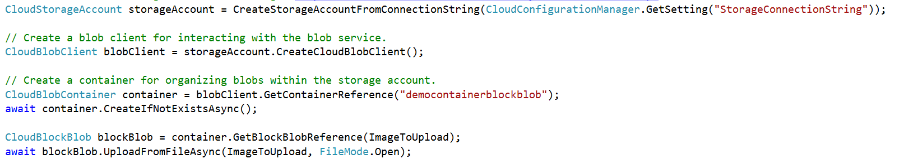
Abstractions – Blobs
Blobs – Massively scalable object store in the cloud
Simple REST interface (Put, Get, Delete)
Data sharing – share documents, pictures, video, music, etc.
Big Data – store raw data/logs and compute/map reduce over data
Backups – data and device backups

Slide 91
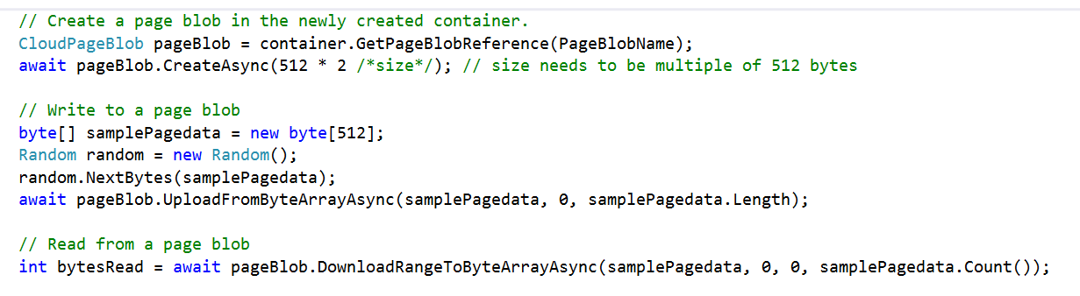
Abstractions – Disks
Persistent disks for VMs in Azure
Disks are VHDs stored in Azure Page Blobs
Page Blobs are optimized for random I/O
VM see the VHD/Blob as a disk
Reads translated to GETs, writes to PUTs
Blob protected by write-lease
Reads from the Blob (and snapshots) still allowed

Slide 92
Azure Files: Lift and Shift FTP Servers
Problem:
Legacy FTP servers that need to be maintained on-prem
Solution:
Move FTP server to IaaS
Move file share to Azure Files
Azure
Load Balancer
App/FTP
Server
VM 1
App/FTP
Server
VM 2
App/FTP
Server
VM 3
Port 445
Port 445
Port 445
\\<storageacct1>.file.windows.net\ftpshare
Azure files
Share 1
Folder 1
Folder 2
Sub Folder 1
Azure
Scenario 1

Slide 93
Lift and Shift DFSN
SQL Server
Setup Azure File shares
Copy data
Setup DFSN
Setup SQL instance
Setup remote instances
Retire SQL instance
Retire DFSN
Retire NAS device
Add new app
End user
5
Virtual client
DFSN
3
4
SQL
on IaaS
DFSN
on IaaS
3
1
Modern
App
REST API
2
Data storage
Azure Files
on Premises
Azure

Slide 94
Azure Files: Best Practices
Performance
Use 1MB IO Size for best throughput
Ensure KB3114025 applied on Windows 8.1 or Server 2012 R2
Security
Use Win 8.x or Server 2012 as Windows clients
Use SMB 2.1 in the same DC for Linux clients
Mount file for correct user context
Enable Port 445 outbound to access Azure Files from On Premise instances
Usability
Write to a file periodically to keep connection open in Linux, until kernel fix is backported
Mount from logged in user context to see drive in Windows Explorer
Notes:
Performance
Use 1MB IO Size to get maximum throughput per share of 60 MB/sec (IOPS x IO Size = Throughput)
Apply KB3114025 to achieve optimal performance for clients running Windows 8.1 or Server 2012 R2
Security
Windows 7 is SMB 2.1 only and it does not support channel encryption. Use Win 8.x or Server 2012
Linux distros do not support encryption in SMB 3.0. Mount using SMB 2.1 in the same DC
Share is not accessible, if app/service is running under different context. Mount share for correct user
Need Port 445 to access Azure Files from On Premise instances
Usability
Write to a file periodically to keep connection open in Linux, until kernel fix is backported
Mount from current user context to see drive in Windows Explorer
[Mine] any Linux client has same problem. Work around: Keep a file in the Azure File share that you write to periodically to sustain the connection and avoid getting into an idle state. This has to be write operation such as, rewriting the created/modified date on the file, otherwise you might get cached results and your operation might not trigger the connection.

Slide 95
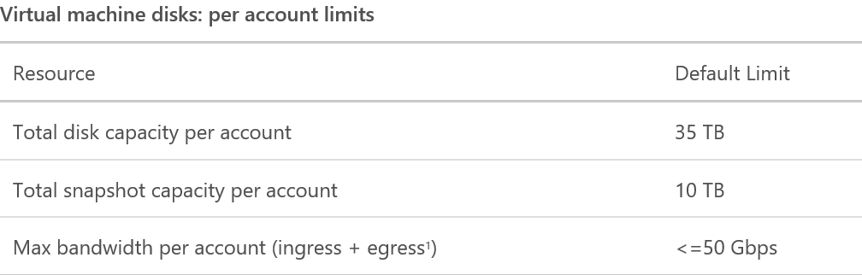
Standard vs. Premium Storage accounts
Premium
Not available in all regions
Storage analytics is not currently supported for Premium Storage. To analyze the performance metrics of VMs using disks on Premium Storage accounts, use the operating system based tools, such as Windows Performance Monitor for Windows VMs and IOSTAT for Linux VMs

Slide 96

Location, durability, and redundancy
With a storage account, the location and durability of the storage accounts must also be taken into account.
Affinity groups allow you to group your Azure services to optimize performance. All services, storage accounts, and VMs within an affinity group will be located in the same Azure datacenter or region
Location refers to which Azure region where the storage account will be deployed
Resource Groups enable you to manage all your resources in an application or service deployed in Microsoft Azure together

Slide 97
Standard versus Premium
Standard – 500 IOPS per disk, 60MB/sec
Premium – Up to 5000 IOPS per disk, 200 MB/sec
A7 VM
8 cores
DS3 VM
4 cores
8,000 IOPS
10,000 IOPS
16 Std. disks
2 P30 disks
Azure IaaS VM using Standard Disks
Use multiple disks to get IOPS
Azure IaaS VM using Premium Disks

Slide 98
Azure Storage APIs
Blobs
Tables
Queues
Service APIs
List Containers
Set/GET Blob Service Properties
Preflight Blob Request
Get Blob Service Stats
Container APIs
Create Container
Get/Set Container Properties/Metadata
Get/Set Container ACL
Lease Container
Delete Container
List Blobs
Blob APIs
Put Blob
Get Blob
Get/Set Blob Properties
Delete Blob
Lease Blob
Snapshot Blob
Copy Blob
Service APIs
Set/Get Table Service Properties
Preflight Table Request
Get Table Service Stats
Query Tables
Table APIs
Create Table
Delete Table
Set/Get Table ACL
Entity APIs
Insert Entity
Update Entity
Merge Entity
Insert Or Merge Entity
Insert Or Replace Entity
Query Entity
Query Entities
Entity Group Transactions
Service APIs
Set/Get Queue Service Properties
Preflight Queue Request
Get Queue Service Stats
List Queues
Queue APIs
Create Queue
Delete Queue
Get/Set Queue Metadata
Get/Set Queue ACL
Message APIs
Put Message
Get Messages
Peek Messages
Delete Message
Update Message
Clear Messages

Slide 99
Azure Premium Storage Disks
For high-performance IO-intensive workloads (databases, etc.)
Consistent low latency and predictable high IO throughput
Durable - 3 strongly consistent copies in SSD storage
New class of VMs – DS Series
Supports up to 1 TB Blob/disk size
Up to 32TB per VM and up to 64,000 IOPS per VM
Flexible Pricing – VMs and disks by the hour
Disk types | P10 | P20 | P30
Disk size | 128 GB | 512 GB | 1024 GB
IOPS per Disk | 500 | 2,300 | 5,000
Throughput per Disk | 100 MB/Sec | 150 MB/Sec | 200 MB/Sec

Slide 100
Azure Storage Architecture
Import / export
Client libraries
(.NET, Java, C++, Android, Node.JS…)
SMB client
REST
REST
REST
Blob/Disk
endpoint
Table
endpoint
Queue
endpoint
File share
endpoint
Massive Scale Out & Auto Load Balancing Index Layer
Distributed Replication Layer

Slide 101
Virtual Machine Storage Architecture
Azure Virtual Machine
C:\
OS Disk
D:\
Temporary Disk
E:\, F:\, etc.
Standard Data Disks
E:\, F:\, etc.
Premium Data Disks
Y:\, Z:\, etc.
SMB Share
Disk Cache
SSD Read Cache
Azure Page Blob
Azure Page Blobs (Premium Storage)
Azure Files

Slide 102
Storage limits

Slide 103
Storage limits
Resource | Default limit
Max number of storage accounts per subscription | 200 (max of 250)
TB per storage account | 500 TB
Max number of Blob containers, Blobs, file shares, tables, queues, entities, or messages per storage account | Only limit is the 500 TB storage account capacity
Max size of a single blob container, table, or queue | 500 TB
Max number of blocks in a Block Blob or Append Blob | 50,000
Max size of a block in a Block Blob or Append Blob | 4 MB
Max size of a Block Blob or Append Blob | 50,000 X 4 MB (approx. 195 GB)
Max size of a Page Blob | 1 TB
Max size of a table entity | 1 MB
Max number of properties in a table entity | 252
Max size of a message in a queue | 64 KB
Max size of a file share | 5 TB
Max size of a file in a file share | 1 TB
Max number of files in a file share | Only limit is the 5 TB total capacity of the file share
Max 8 KB IOPS per share | 1000
Max number of files in a file share | Only limit is the 5 TB total capacity of the file share
Max number of Blob containers, Blob, file shares, tables, queues, entities, or messages per storage account | Only limit is the 500 TB storage account capacity
Max number of stored access policies per container, file share, table, or queue | 5

Slide 104
Storage limits
Resource | Default Limit
Total Request Rate (assuming 1KB object size) per storage account | Up to 20,000 IOPS, entities per second, or messages per second
Target throughput for single Blob | Up to 60 MB per second, or up to 500 requests per second
Target throughput for single queue (1 KB messages) | Up to 2000 messages per second
Target throughput for single table partition (1 KB entities) | Up to 2000 entities per second
Target throughput for single file share | Up to 60 MB per second
Max ingress² per storage account (US Regions) | 10 Gbps if GRS/ZRS³ enabled, 20 Gbps for LRS
Max egress² per storage account (US Regions) | 20 Gbps if RA-GRS/GRS/ZRS³ enabled, 30 Gbps for LRS
Max ingress² per storage account (European and Asian Regions) | 5 Gbps if GRS/ZRS³ enabled, 10 Gbps for LRS
Max egress² per storage account (European and Asian Regions) | 10 Gbps if RA-GRS/GRS/ZRS³ enabled, 15 Gbps for LRS
²Ingress refers to all data (requests) being sent to a storage account.
Egress refers to all data (responses) being received from a storage account.

Slide 105
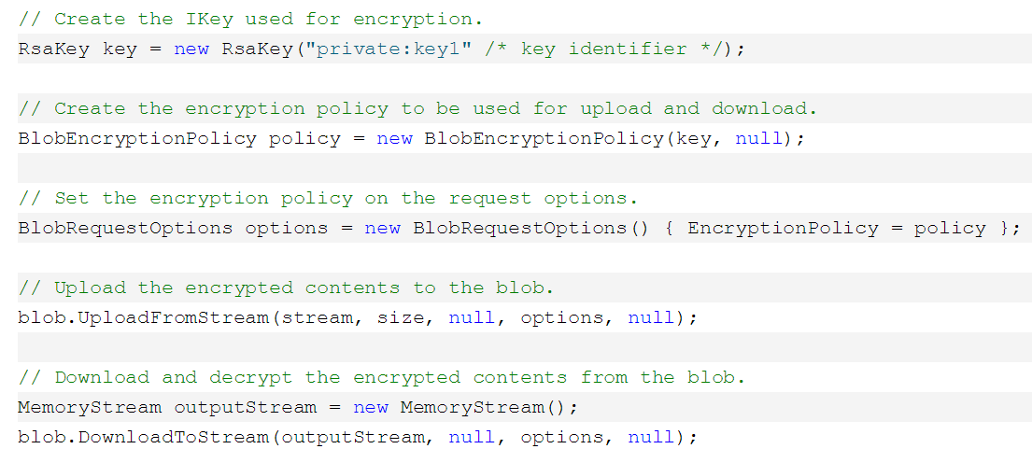
Encryption Client Library
Code is very straightforward:

Slide 106
Naming convention models
Storage account
Restrictions: 3-24 characters in length, use numbers and lower case letters only, must be unique across Azure.
Recommendation: Naming should be representative of its content.
Storage Blob container
Restrictions: Must start with a letter, and can only contain letters, numbers, and (-) char.
No consecutive (-) permitted.
All letters must be lower case.
Names are 3-63 characters long.
Recommendation: Naming should be representative of its content.
Storage Blob
Restrictions: No longer than1024 chars. Case sensitive names. Reserved URLs must be properly escaped. Cannot exceed 254 path segments.
Recommendation: Naming should be representative of its content.

Slide 107
Naming convention models
Queues
Restrictions: Must be unique in Azure and have a valid DNS name. Must start with a letter or number. Can only contain letters or numbers and the (-) char.
Consecutive (-) characters not permitted, must start with a letter or number.
All letters must be lowercase. Only 3 through 63 characters long.
Recommendation: Naming should be representative of its content.
Tables
Restrictions: Names must be unique within an account. May only contain alphanumeric characters. Cannot being with a numeric character. Names are case sensitive. Must have between 3-63 characters. Tables have reserved names such as “tables.”
Recommendation: Naming should be representative of its content.

Slide 108
Storage deployment models

Slide 109
Storage design
Storage accounts have many variables
Establish a storage “stamp” model
Determine initial storage account footprint based on workload requirements
Determine process and policy where a new stamp would be created or extended
Typical “stamp” would include these storage accounts:
LRS
GRS
Premium Storage

Slide 110
Storage account types and services models
Storage accounts for different purposes
Dedicate a storage account for maintenance of master images to be deployed to other storage accounts
Dedicate a storage account for backup, separate from production data and in a separate region than the primary data
Storage services for unique capabilities
Tables: Key lookups at a scale for structured data
Blobs: Retrievals of large amount of raw data such as streaming files, storing media or unstructured text, backups, and binary data. Also, for IaaS VMs VHDs
Queues: Process workflows or decoupling applications
Files: Share between applications running in your VMs

Slide 111
Storage account types and services models
Blob storage: Block Blob vs. Page Blob
Page Blob: Used for random read/write operations (VMs and VHDs). Only allowed up to 1TB and immediate commit
Block Blob: Used for streaming and storing documents, videos, pictures, backups, and unstructured text or binary data. Only allowed up to 200 GB and commits only until issued
Storage and access for random access data
Azure files: Used when multiple IaaS/PaaS VMs with SMB standard interface or UNC path need to access the same data
Azure Blobs: Used for larger capacity, random access for multiple disks, and access from anywhere
Azure data disks: Used when data access is exclusive to the VM attached

Slide 112
Account types and services models
Storage costs
Type of data will be cost driver, critical data might need GRS whereas less critical data may suffice with just LRS
Quick Access Data with high IOPS will drive the usage of Premium Storage, while lower requirements may accept Standard Storage
Containers for organizing data
Use containers similar to how a folder structure in a file server would be used
By default, all VHDs will be put into the “vhds” container in a storage account. However, this destination can be changed

Slide 113
Storage account types and services models
Concurrency settings
Blob service allows you to specify optimistic or pessimistic concurrency to manage access to Blob and containers. Last write winds by default
For IaaS, concurrency settings do not need to be modified. While for PaaS, developers need to take concurrency into consideration depending on the app and user base data types
Storage account limits
Primary Constrain: Amount of VHD files a single storage account allows and storage account requests limits
Basic Tier VMs: No more than 66 highly used VHDs in a storage account. Only allowed 20,000/300 request rate limit
Standard Tier VMs: No more than 40 highly used VHDs in a storage account. Only allowed 20,000/500 request rate limit

Slide 114
Storage account types and services models
Amount of storage accounts to use
Storage account throughput is determining factor for using a single or multiple storage accounts
Throughput can be maximized with: More simultaneous outstanding IO, Single Blob: Parallel page or block writes. Multiple Blobs: Upload in Blob in parallel

Slide 115
Location, durability, and redundancy models
Plan with failure in mind
Ensure applications and workloads have “retry options” on storage connection failures
No code changes would be required, but small latency may occur. Plan for latency sensitive apps to use cache options

Slide 116
Storage for IaaS models
IaaS design storage account dependency
Refer to storage account limits for the amount of VHD files allowed per storage account. Unless it’s known that these VHDs are not highly used the place more than the suggested limit in the storage account
VM images and storage account dependency
Store all custom VM images in separate dedicated storage accounts. Deploy by copying an image from one storage account to another, this keeping images isolated and protected. Keep the permissions to the image deployment engineers
Never deploy an image over VPN connection

Slide 117
Storage for IaaS models
Multiple data disks in single volumes
If multiple data disks need to appear as a single volume, this is not possible in a storage account type GRS
Use LRS type storage accounts, or if GRS is a requirement, each data disk must be kept as a separate volume
Disk cache and VM performance
Only change the host caching default settings for the OS and data disks if the workload would benefit from the change to improve performance
Consider, that cache settings changes for the OS disk require a reboot, while cache changes for the data disks do not

Slide 118
Storage for IaaS models
High performance storage for Azure workloads
Use Premium Storage for demanding enterprise applications like Dynamics AX, Dynamics CRM, Exchange Server, SharePoint Farms, and SAP Business Suite
High performance storage for database workloads
Use Premium Storage for performance intensive database workloads like SQL Server, Oracle, MongoDB, MySQL, and Redis, that require consistent high performance and low latency

Slide 119
Storage management model
Understand data suitability through the following factors:
Understand data privacy laws that may apply to the customer’s country, industry, and any regulatory bodies that may govern it
Understand the sensitivity of data that may be stored in the cloud
Understand the technical aspects of access frequency and active vs. passive data

Slide 120
Storage monitoring model
Understand monitoring needs:
Start your initial Azure deployments by enabling storage monitoring and analytics
Enable monitoring during testing to establish baseline metrics
Enable monitoring in production to assist in troubleshooting

